Slide 1
INFO6003 Lab-10
SudipPokhrel
1072933

Slide 2
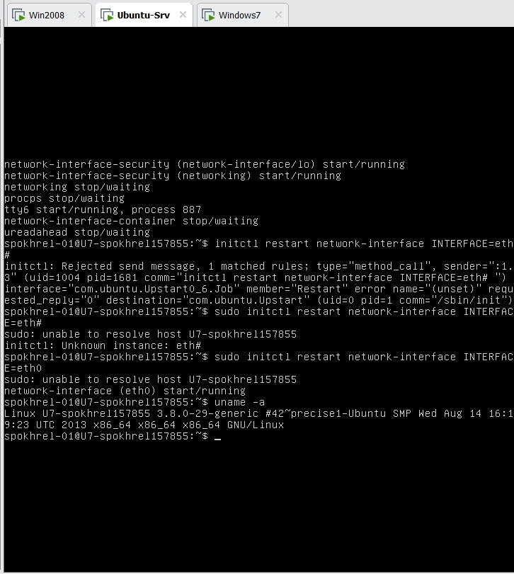
Slide #1

Slide 3
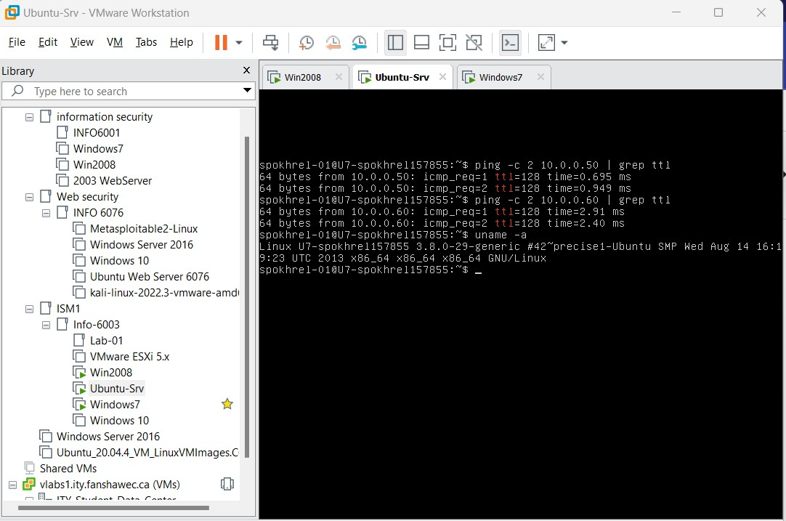
Slide #2

Slide 4
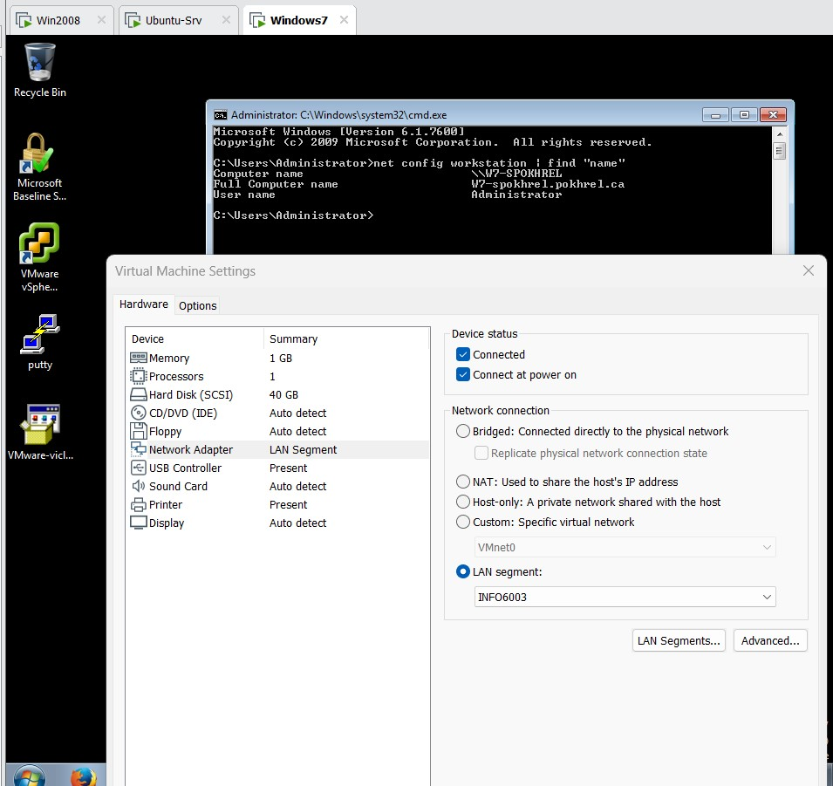
Slide #3

Slide 5
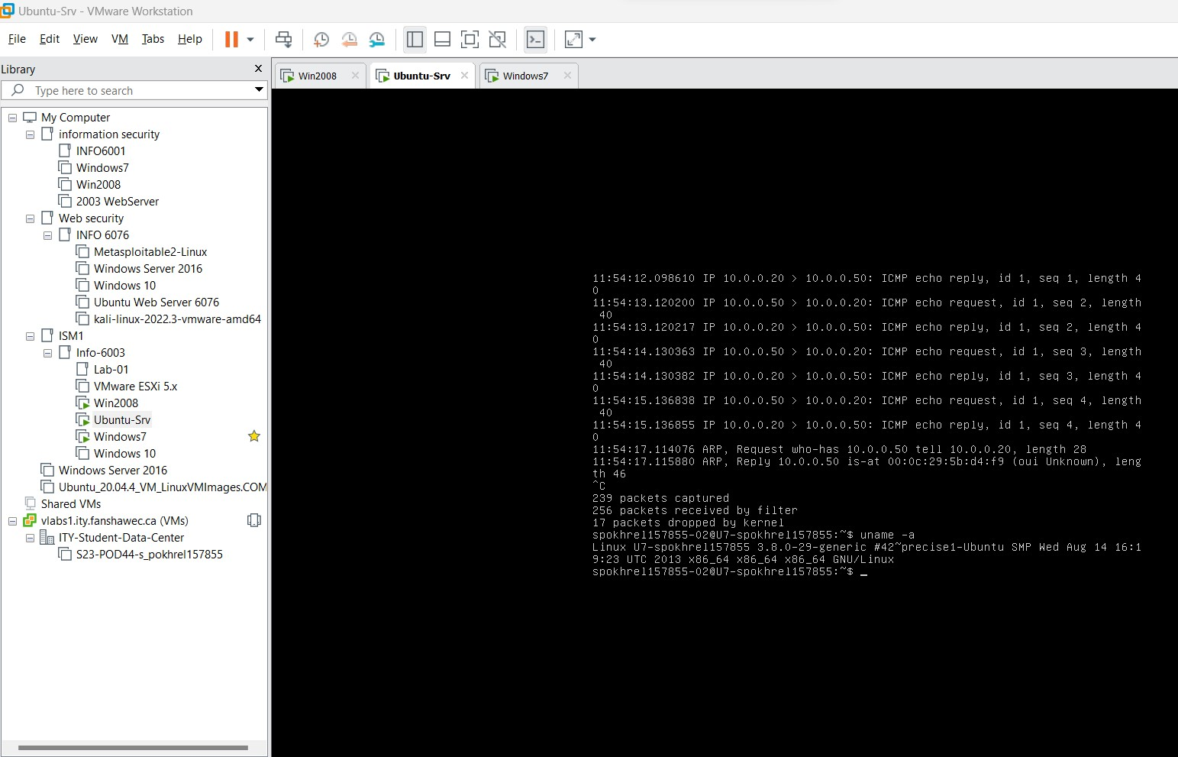
Slide #4

Slide 6
Slide #5
Which specific service do you think we will want to restart? Network-Interface(eth0) This command will fail, why did it fail? Fix the command and run it again sudo initctl restart network-interface INTERFACE=eth0 we need to give sudo priviliges for the command to run What does the -n do? You can use man tcpdump to find out. This flag tells tcpdump not to resolve IP addresses to hostnames. When using this option, the output will display IP addresses instead of domain names. This can be useful to avoid DNS lookups and make the output more concise. What does the error tell you? spokhrel157855-02 is not a sudoer. We need to give it sudo priviliges for it to work

